Slide 1



17ᵗʰ Workshop-School on Agents, Environments and Applications – UFPel – Pelotas
Introduction to Distributed and Embedded Multi-agent Systems
Carlos Eduardo Pantoja¹
Nilson Mori Lazarin^{1,2}
1. Centro Federal de Educação Tecnológica (CEFET/RJ) - 2. Universidade Federal Fluminense (UFF), Brasil
1 de Setembro 2023, Pelotas, RS

Slide 2
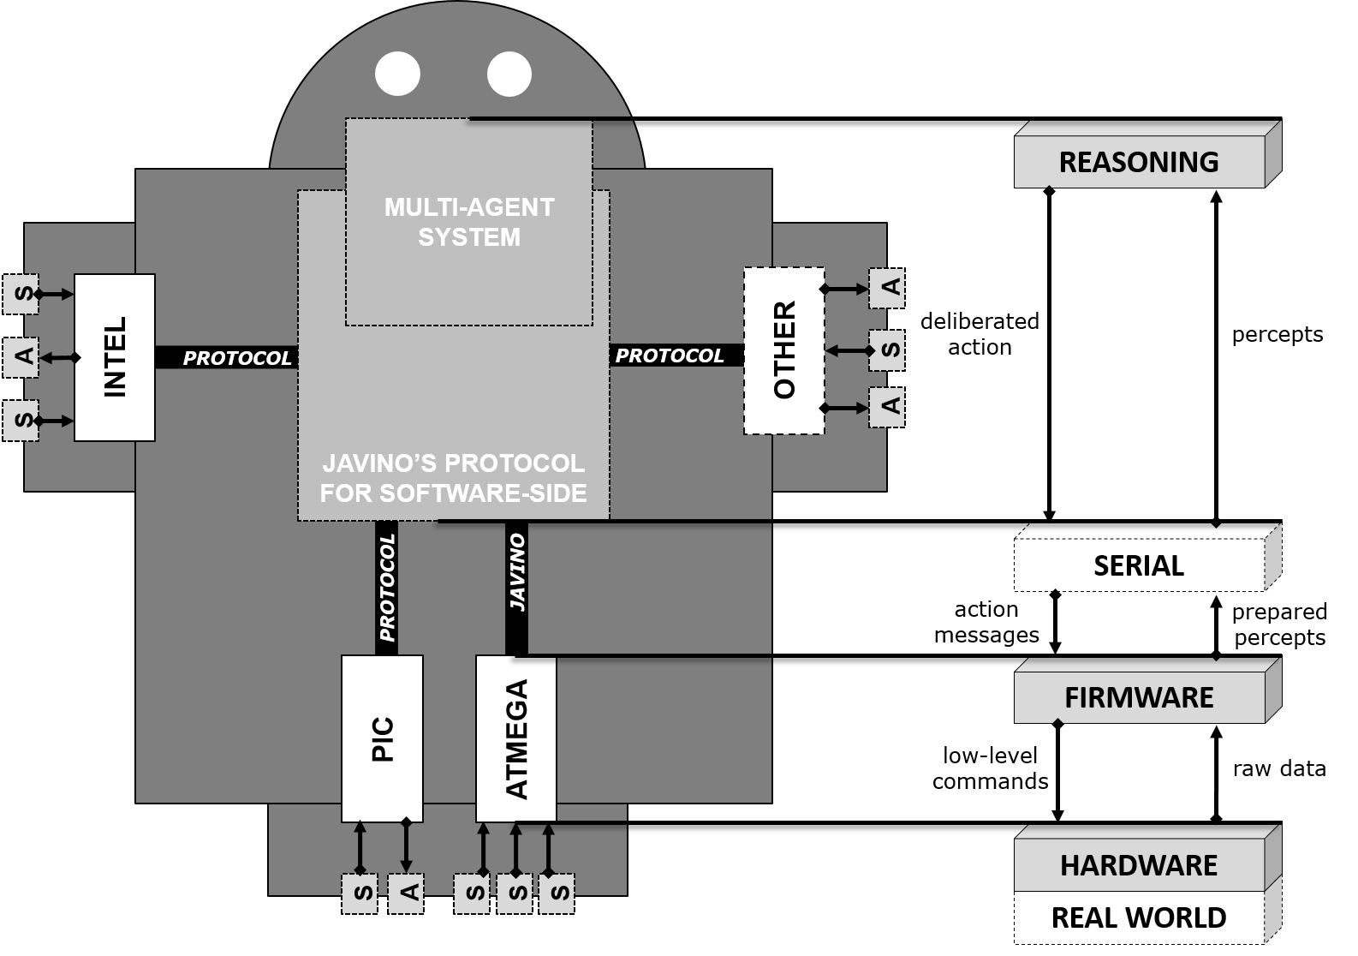
REASONING LAYER USING CHONIDE
Notes:
<número>

Slide 3
Introduction
Embedded MAS
It is a system based on agents that provides autonomy, proactivity, and social ability to a physical device.
There is no remote control or external processing.
WOOLDRIDGE, Michael. Intelligent Agents. Multiagent Systems: A Modern Approach to Distributed Artificial Intelligence. Cambridge, MA, USA: MIT Press, 1999. p. 27–77
BRANDÃO, FABIAN CESAR; LIMA, MARIA ALICE TRINTA; PANTOJA, CARLOS EDUARDO; ZAHN, JEAN; VITERBO, JOSÉ. Engineering Approaches for Programming Agent-Based IoT Objects Using the Resource Management Architecture. SENSORS, v. 21, p. 8110. Disponível em: https://doi.org/10.3390/s21238110.
Notes:
<número>

Slide 4
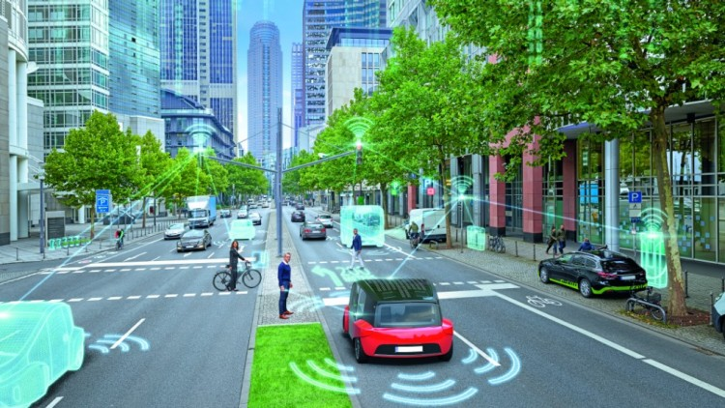
Embodied or embedded agents: Conventional approaches
T. LEPPÄNEM et al., Mobile Agents for Integration of Internet of Things and Wireless Sensor Networks. 2013 IEEE International Conference on Systems, Man, and Cybernetics, Manchester, UK, 2013, pp. 14-2.
C. SAVAGLIO, G. FORTINO and M. ZHOU, Towards interoperable, cognitive and autonomic IoT systems: An agent-based approach. 2016 IEEE 3rd World Forum on Internet of Things (WF-IoT), Reston, VA. M. E. PÉREZ HERNÁNDEZ and S. REIFF-MARGANIEC, Towards a Software Framework for the Autonomous Internet of Things. 2016 IEEE 4th International Conference on Future Internet of Things and Cloud (FiCloud), Vienna, Austria, 2016, pp. 220-227
HERINGER, V. H.; BARROS, R. S.; PANTOJA, C. E.; MACHADO, L.; LAZARIN, N. M. An Agent-oriented Ground Vehicle’s Automation using Jason Framework. In : International Conference on Agents and Artificial Intelligence, 2014, ESEO. Proceedings of the 6th International Conference on Agents and Artificial Intelligence. p. 261-266.
Notes:
<número>

Slide 5
Embodied or embedded agents: Conventional approaches
Centralised Solution
Notes:
<número>

Slide 6
Embodied or embedded agents: Conventional approaches
Centralised Solution
one agent p. device
agent
agent
agent
agent
agent
agent
agent
Notes:
<número>

Slide 7
Embodied or embedded agents: Conventional approaches
Centralised Solution
one agent p. device
performance issues
only one agent into the device;
a lot of sensors.
agent
agent
agent
agent
agent
agent
agent
Notes:
<número>

Slide 8
Embodied or embedded agents: Conventional approaches
Centralised Solution
one agent p. device
performance issues
only one agent into the device;
a lot of sensors.
reactive artifact
artifact
artifact
artifact
artifact
agent
agent
artifact
agent
agent
agent
agent
agent
Notes:
<número>

Slide 9
Embodied or embedded agents: Conventional approaches
Centralised Solution
one agent p. device
performance issues
only one agent into the device;
a lot of sensors.
reactive artifact
are data oriented
don’t have decision-making
artifact
artifact
artifact
artifact
agent
agent
artifact
agent
agent
agent
agent
agent
Notes:
<número>

Slide 10
Embodied or embedded agents: Conventional approaches
Centralised Solution
one agent p. device
performance issues
only one agent into the device;
a lot of sensors.
reactive artifact
are data oriented
don’t have decision-making
depends on a server
artifact
artifact
artifact
artifact
agent
agent
artifact
agent
agent
agent
agent
agent
Notes:
<número>

Slide 11
Our approach
Distributed Solution
Notes:
<número>

Slide 12
Our approach
Distributed Solution
one MAS p. device
Embedded MAS
Embedded MAS
Embedded MAS
Embedded MAS
Embedded MAS
Embedded MAS
Embedded MAS
Notes:
<número>

Slide 13
Our approach
Distributed Solution
one MAS p. device
truly autonomy
Embedded MAS
Embedded MAS
Embedded MAS
Embedded MAS
Embedded MAS
Embedded MAS
Embedded MAS
Notes:
<número>

Slide 14
Our approach
Distributed Solution
one MAS p. device
truly autonomy
communicability dependency only for external communication
Embedded MAS
Embedded MAS
Embedded MAS
Embedded MAS
Embedded MAS
Embedded MAS
Embedded MAS
Notes:
<número>

Slide 15
Our approach
Edge Intelligence
Embedded MAS
Embedded MAS
Embedded MAS
Embedded MAS
Embedded MAS
Embedded MAS
Embedded MAS
Notes:
<número>

Slide 16
Our approach
Edge Intelligence
one MAS p. artifact
Embedded MAS
Embedded MAS
Embedded MAS
Embedded MAS
Embedded MAS
Embedded MAS
Embedded MAS
Embedded MAS
Embedded MAS
Embedded MAS
Embedded MAS
Embedded MAS
Notes:
<número>

Slide 17
Our approach
Edge Intelligence
one MAS p. artifact
pro-active artifact
decision-making in the edge
Embedded MAS
Embedded MAS
Embedded MAS
Embedded MAS
Embedded MAS
Embedded MAS
Embedded MAS
Embedded MAS
Embedded MAS
Embedded MAS
Embedded MAS
Embedded MAS
Notes:
<número>

Slide 18
Toolkit to Facilitate Embedded MAS Development
Notes:
<número>

Slide 19

Toolkit to Facilitate Embedded MAS Development
J
Notes:
<número>

Slide 20

Javino
J
LAZARIN, Nilson Mori; PANTOJA, Carlos Eduardo. A robotic-agent platform for embedding software agents using raspberry pi and arduino boards. In: 9TH SOFTWARE AGENTS, ENVIRONMENTS AND APPLICATIONS SCHOOL, 2015. Proceedings WESAAC 2015 [...]. Niteroi: UFF, 2015. p. 13–20. Disponível em: http://www2.ic.uff.br/~wesaac2015/Proceedings-WESAAC-2015.pdf.
Notes:
<número>

Slide 21
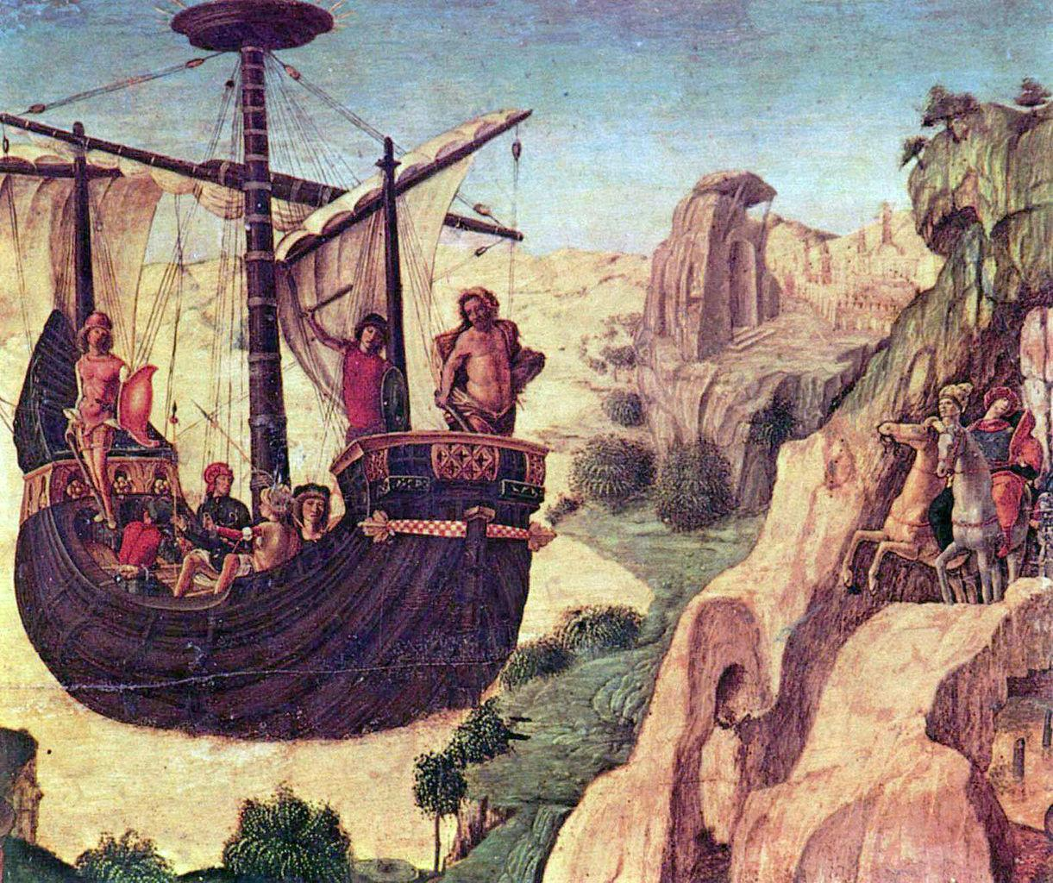
Argo Agents
A
J
ARGO
Pantoja, C.E., Stabile, M.F., Lazarin, N.M., Sichman, J.S. (2016). ARGO: An Extended Jason Architecture that Facilitates Embedded Robotic Agents Programming. In: Baldoni, M., Müller, J., Nunes, I., Zalila-Wenkstern, R. (eds) Engineering Multi-Agent Systems. EMAS 2016. Lecture Notes in Computer Science(), vol 10093. Springer, Cham. https://doi.org/10.1007/978-3-319-50983-9_8
Notes:
<número>

Slide 22

Communicator Agents
A
J
ARGO
C
Communicators
PANTOJA, Carlos Eduardo; SOARES, Heder Dorneles; VITERBO, José; et al. Exposing IoT Objects in the Internet Using the Resource Management Architecture. International Journal of Software Engineering and Knowledge Engineering, v. 29, n. 11n12, p. 1703–1725, 2019.
Notes:
<número>

Slide 23
Bio-Inspired Protocols
A
J
ARGO
Bio-Inspired Protocols
C
Communicators
Souza de Jesus V., Pantoja C., Manoel F., Alves G., Viterbo J. and Bezerra E. (2021). Bio-Inspired Protocols for Embodied Multi-Agent Systems.In Proceedings of the 13th International Conference on Agents and Artificial Intelligence - Volume 1: ICAART, ISBN 978-989-758-484-8, pages 312-320. DOI: 10.5220/0010257803120320
Notes:
<número>

Slide 24
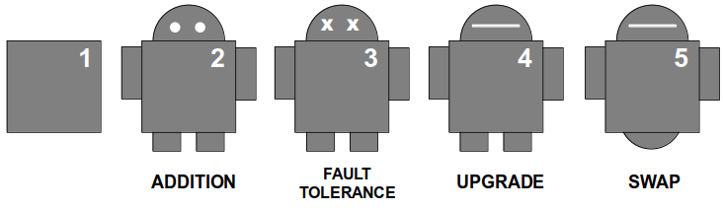
Swapping Physical Resources at Runtime
A
J
ARGO
Bio-Inspired Protocols
C
Communicators
Lazarin, N.; Pantoja, C. and Viterbo, J. (2023). Swapping Physical Resources at Runtime in Embedded MultiAgent Systems. In Proceedings of the 15th International Conference on Agents and Artificial Intelligence - Volume 1: ICAART; ISBN 978-989-758-623-1; ISSN 2184-433X, SciTePress, pages 93-104. DOI: 10.5220/0011750700003393
Notes:
<número>

Slide 25
Jason Embedded and Packages
A
J
ARGO
Bio-Inspired Protocols
C
Communicators
PANTOJA, CARLOS EDUARDO; JESUS, VINICIUS SOUZA; LAZARIN, NILSON MORI; VITERBO, JOSÉ. A Spin-off Version of Jason for IoT and Embedded Multiagent Systems. In : Proceedings of the 12nd Brazilian Conference on Intelligent Systems, BRACIS 2023, Belo Horizonte, Brazil, 2023
Notes:
<número>

Slide 26
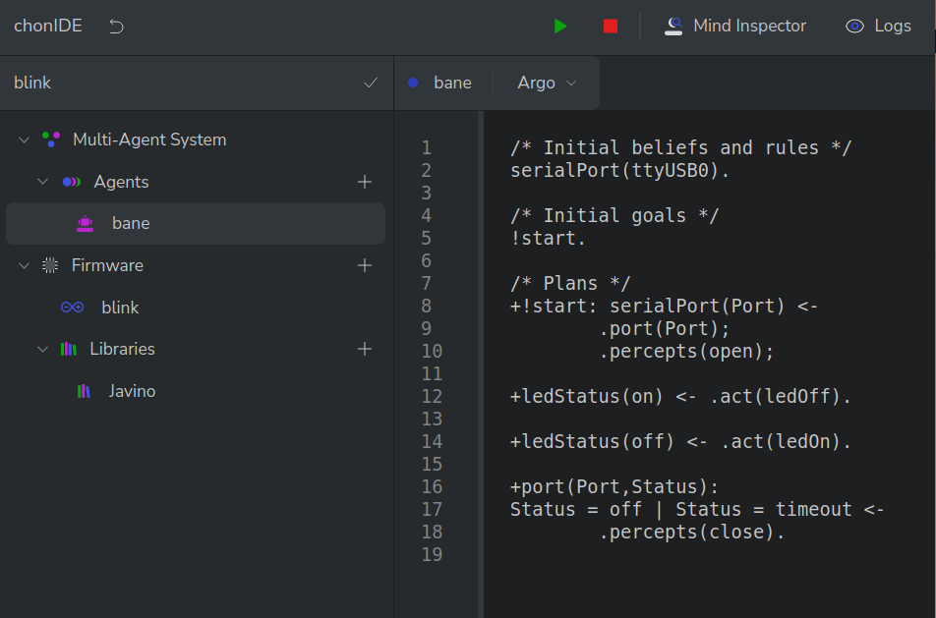
ChonIDE
Souza de Jesus, V., Mori Lazarin, N., Pantoja, C.E., Vaz Alves, G., Ramos Alves de Lima, G., Viterbo, J. (2023). An IDE to Support the Development of Embedded Multi-Agent Systems. In: Mathieu, P., Dignum, F., Novais, P., De la Prieta, F. (eds) Advances in Practical Applications of Agents, Multi-Agent Systems, and Cognitive Mimetics. The PAAMS Collection. PAAMS 2023. Lecture Notes in Computer Science(), vol 13955. Springer, Cham. https://doi.org/10.1007/978-3-031-37616-0_29
Notes:
<número>

Slide 27



Agradecimentos
OBRIGADO!
pantoja@cefet-rj.br
nilson.lazarin@cefet-rj.br
vsjesus@id.uff.br
fabiancpbm@gmail.com
Notes:
<número>

